Slide 1
Motion Simple Pendulum
ϴ
Force = mg sin (ϴ)
Force = mg cos (ϴ)
LabRat Scientific
© 2018
Force = Weight = mg

Slide 2
A simple pendulum can be considered to be a “energy conversion machine”, which involves two types of “mechanical energy”
Gravitational Potential Energy
Kinetic Energy
The pendulum converts potential energy into kinetic energy and then kinetic energy into potential energy as it swings back and forth.

Slide 3
Gravitational Potential Energy
Potential Energy is “stored” energy that has the potential to do work.
The term “Gravitational” Potential Energy is used because there are many forms of potential energy – such as:
Potential Energy in a compressed spring (mechanical PE)
Potential Energy in a stick of dynamite (chemical PE)
Potential Energy in pressurized bottle (mechanical PE)
Potential Energy in a battery (electrical PE)

Slide 4
Gravitational Potential Energy
Gravitational PE = mgh
Gravitational PE = Mass x Accel due to Gravity x Height
The Height (h) does not have a fixed reference. On earth, it would ideally be the height above the center of the earth. However, this is not the most practical reference point in simple pendulum calculations and experiments.
Since we generally deal with “change” in energy, we can arbitrarily select our “zero” height position as long as it makes physical sense (more on that later).

Slide 5
Kinetic Energy
Kinetic Energy is the energy of “motion”. Everything that is in motion has kinetic energy...
Kinetic Energy (KE) = ½ x Mass x Vel²
From this equation it can be seen that as the mass of the moving object increases, so does the kinetic energy on a one-to-one basis. (In other words, double the mass and you double the kinetic energy)...
The equation also says that the kinetic energy will increase by the square of the velocity. If we double the velocity, we quadruple the kinetic energy...

Slide 6
Pendulum Nomenclature
A
The angle (ϴ ) = 0 when the bob is hanging straight down
ϴ
The Length is measured from the attach point (A) to the CG of the bob
Length (L)
Pendulum Bob
Height (h)
h = 0.0
Height = 0 when the bob is hanging straight down

Slide 7
Calculating the Height of the Pendulum Bob
Recall:
Opp
Sin (ϴ ) = -------
Hyp
30⁰
Length (L)
Y = Length x cos (30)
Adj
Cos (ϴ ) = -------
Hyp
Length (L)
Height (h)
Check: As angle becomes 0 ⁰,
Cos (0) = 1, and thus we get Height = Length - Length = 0
Height = Length - ( (Length x cos (30) )

Slide 8
Components of Gravitational Acceleration acting on the Pendulum Bob
Recall:
Opp
Sin (ϴ ) = -------
Hyp
ϴ
The Purple Force, which is acting perpendicular to the pendulum string, is what accelerates the bob. This force is always changing because the angle is always changing.
Adj
Cos (ϴ ) = -------
Hyp
Force = mg sin (ϴ)
Force = mg cos (ϴ)
ϴ
Check: When the angle becomes 0⁰ , Sin (0⁰) becomes zero, and the force becomes zero. As such, there is no acceleration acting on the bob at the bottom of the swing. However, the bob does have velocity and as it begins to swing upwards, gravity begins to decelerate it. Eventually the velocity will become zero and the bob will fall back…
Force = Weight = mg

Slide 9
Components of Gravitational Acceleration acting on the Pendulum Bob
The bob decelerates as it swings upward.
The bob accelerates as it swings downward.
The bob has no acceleration/deceleration for a brief moment at the bottom of the swing.

Slide 10
Examining the Instantaneous KE and PE in a Swinging Pendulum
A simple simulation can be written using a spreadsheet (see LabRatScientific website) to determine the motion of the pendulum and the Potential and Kinetic Energy at any time during the oscillation.
The results of this simulation are given in the next few slides…

Slide 11
At the top of the swing, the bob will stop and then fall back in the other direction. At this maximum height the velocity is once again zero and the Kinetic Energy is zero
When the bob is held at the release point (30 deg) it is motionless and thus has no Kinetic Energy
When the bob is at the bottom of the swing it has maximum velocity and thus maximum Kinetic Energy
Angle (deg)
30
-30

Slide 12
When the bob is at the bottom of the swing it has a height = 0 making the Potential Energy = 0
At the top of the swing, the bob once again achieves the maximum height, and thus the Potential Energy is once again maximized
When the bob is held at the release point (30 deg) it is at its highest position and thus has maximum Potential Energy
Angle (deg)
30
-30

Slide 13
Notice that the magnitude of PE is the same as the magnitude of KE
Notice that when PE is at a maximum, the KE is at a minimum
Angle (deg)
30
-30

Slide 14
Energy Balance
For a simple pendulum:
The maximum potential energy is equal to the maximum kinetic energy.
At any point in time during the oscillation, the sum of the potential energy and the kinetic energy will equal the maximum energy in the system (either maximum PE or maximum KE which have the same magnitude).
Once released, the total energy of the system will not increase. This means the maximum “height” of the pendulum bob will never get higher…
In the real world (not the frictionless theoretical world) the oscillation of a pendulum will damp out over time due to air friction and mechanical friction.

Slide 15
Period of Oscillation
A simple equation can be used to calculate the time it takes to make one complete swing (from the release point and back)
∏ = 3.1416
L
Period (T) = 2 ∏ x ----
g
L = Length of string
g = Acceleration Due to Gravity
Notice that this equation does not involve the weight (or mass) of the pendulum bob...
This means that the system is independent of mass and if two pendulums of the same length have two different bob masses, they will both still swing in unison with the same period of oscillation…

Slide 16
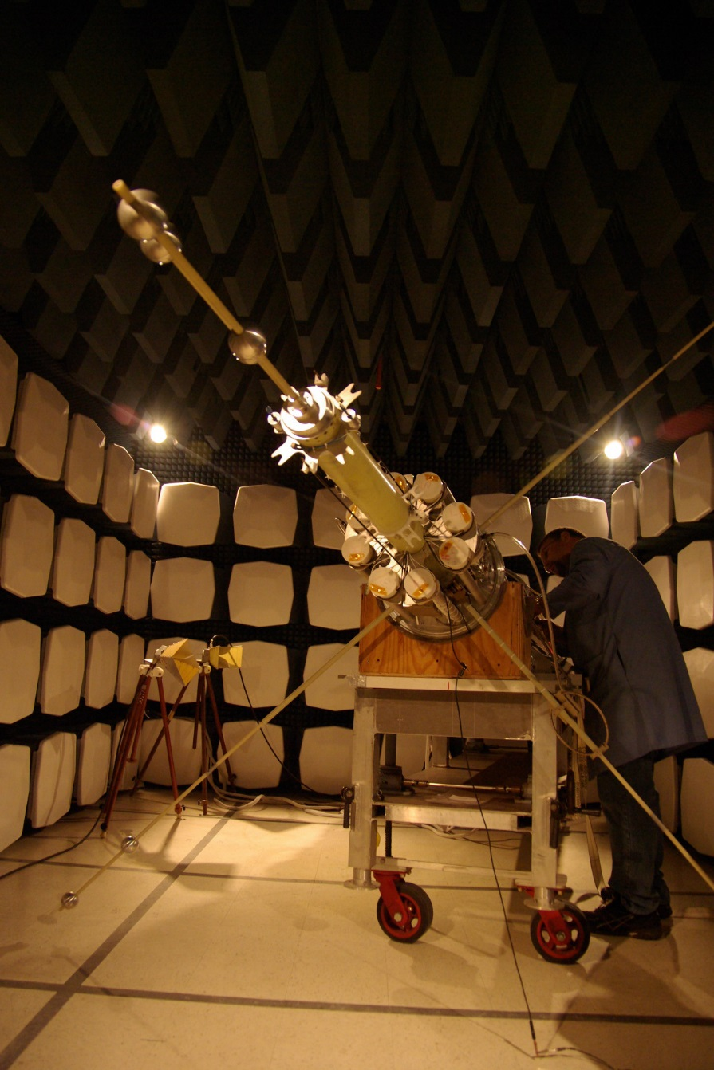
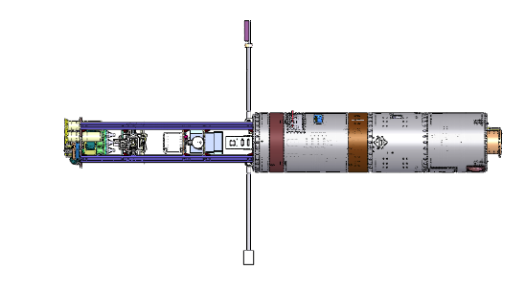
Another form of “Pendulum”
NASA Sounding Rocket plasma physics payloads often include “booms” that have sensors mounted at the ends.
When the booms swing out and hit their stops during deployment they act just like pendulums. The oscillations can result in undesirable payload dynamics which the scientists don’t like….

Slide 17
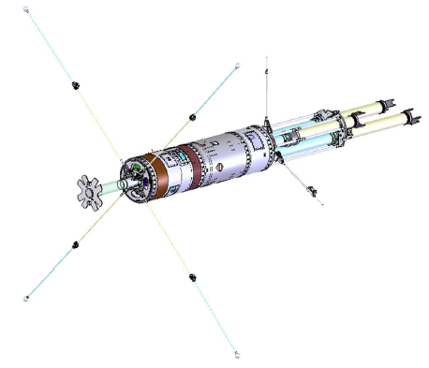
Sounding Rocket Booms
The boom bends after it deploys and hits the locking mechanism. It is this bending of the boom material that creates the “springiness” that sets up the pendulum-like oscillation.

Slide 18
Sounding Rocket Booms
Since energy is usually lost over time in a system like this, the oscillations will eventually damp out and become zero.

Slide 19
QUESTIONS ?

